Slide 1
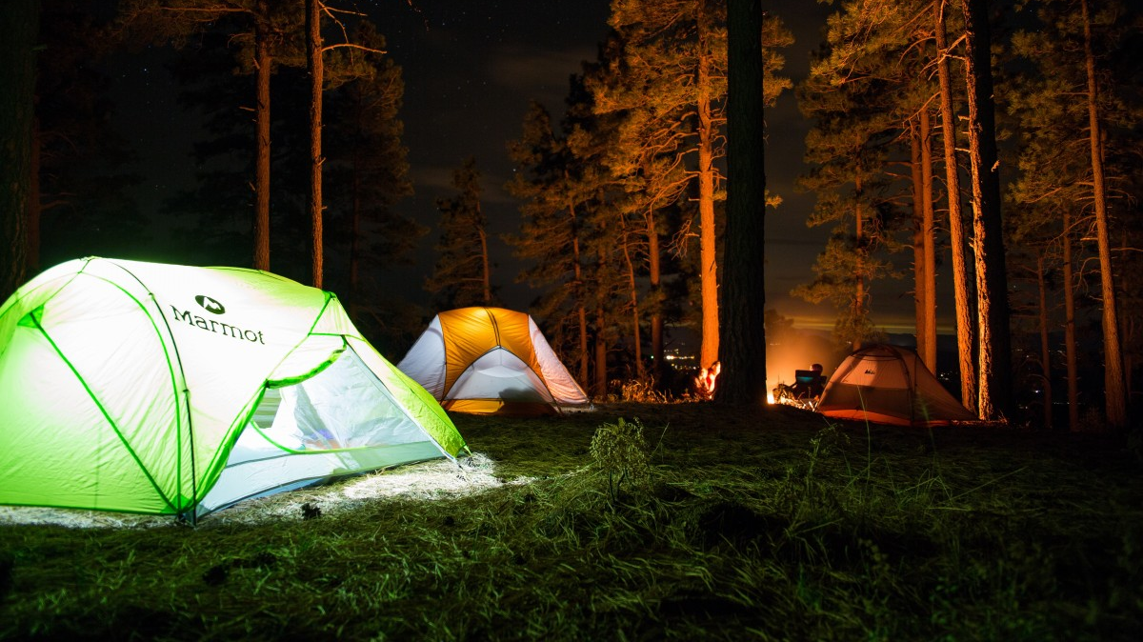

TsaDiree®
Lazanas D. Tsalmpouris A.

Slide 2
What we did
In our assignment, we were tasked to create a user-friendly “Smart Camping” application.
We made a Hierarchical Task Analysis, designed some prototypes and evaluated them using Norman’s model.
Finally, we wrote all necessary documentation.

Slide 3
H.T.A.
Hierarchical Task Analysis

Slide 4
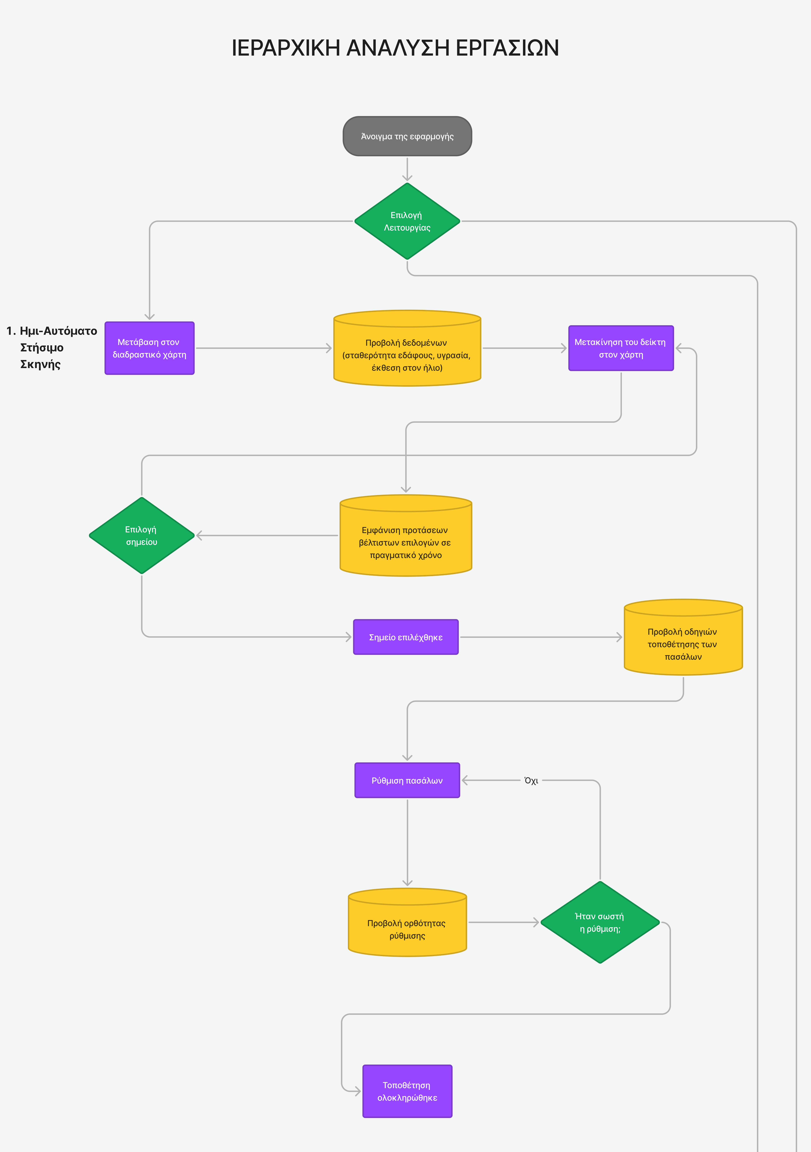
H.T.A. for Tent Setup

Slide 5
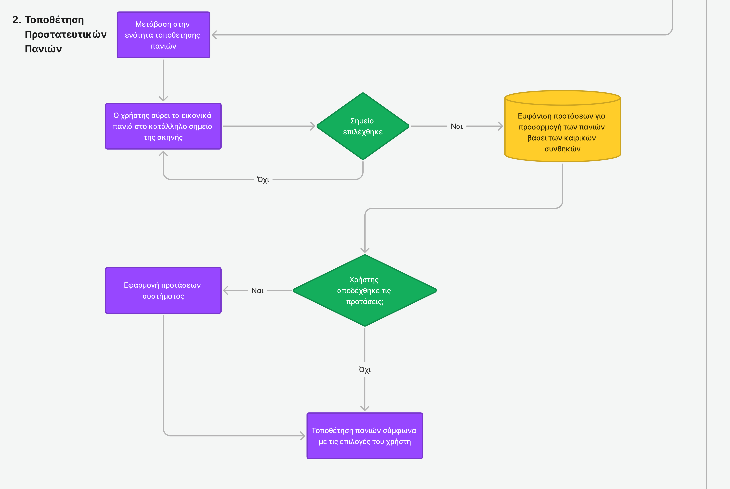
H.T.A. for cloth placement

Slide 6
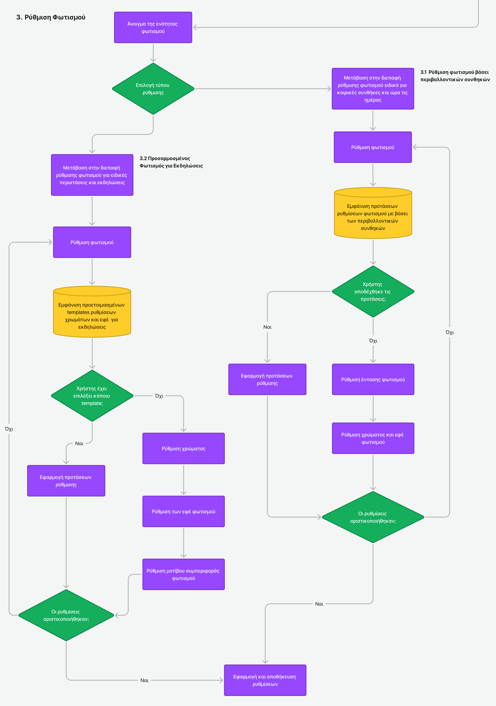
H.T.A. for Lighting Settings

Slide 7
Interface Overview
Smart Camp made easy

Slide 8
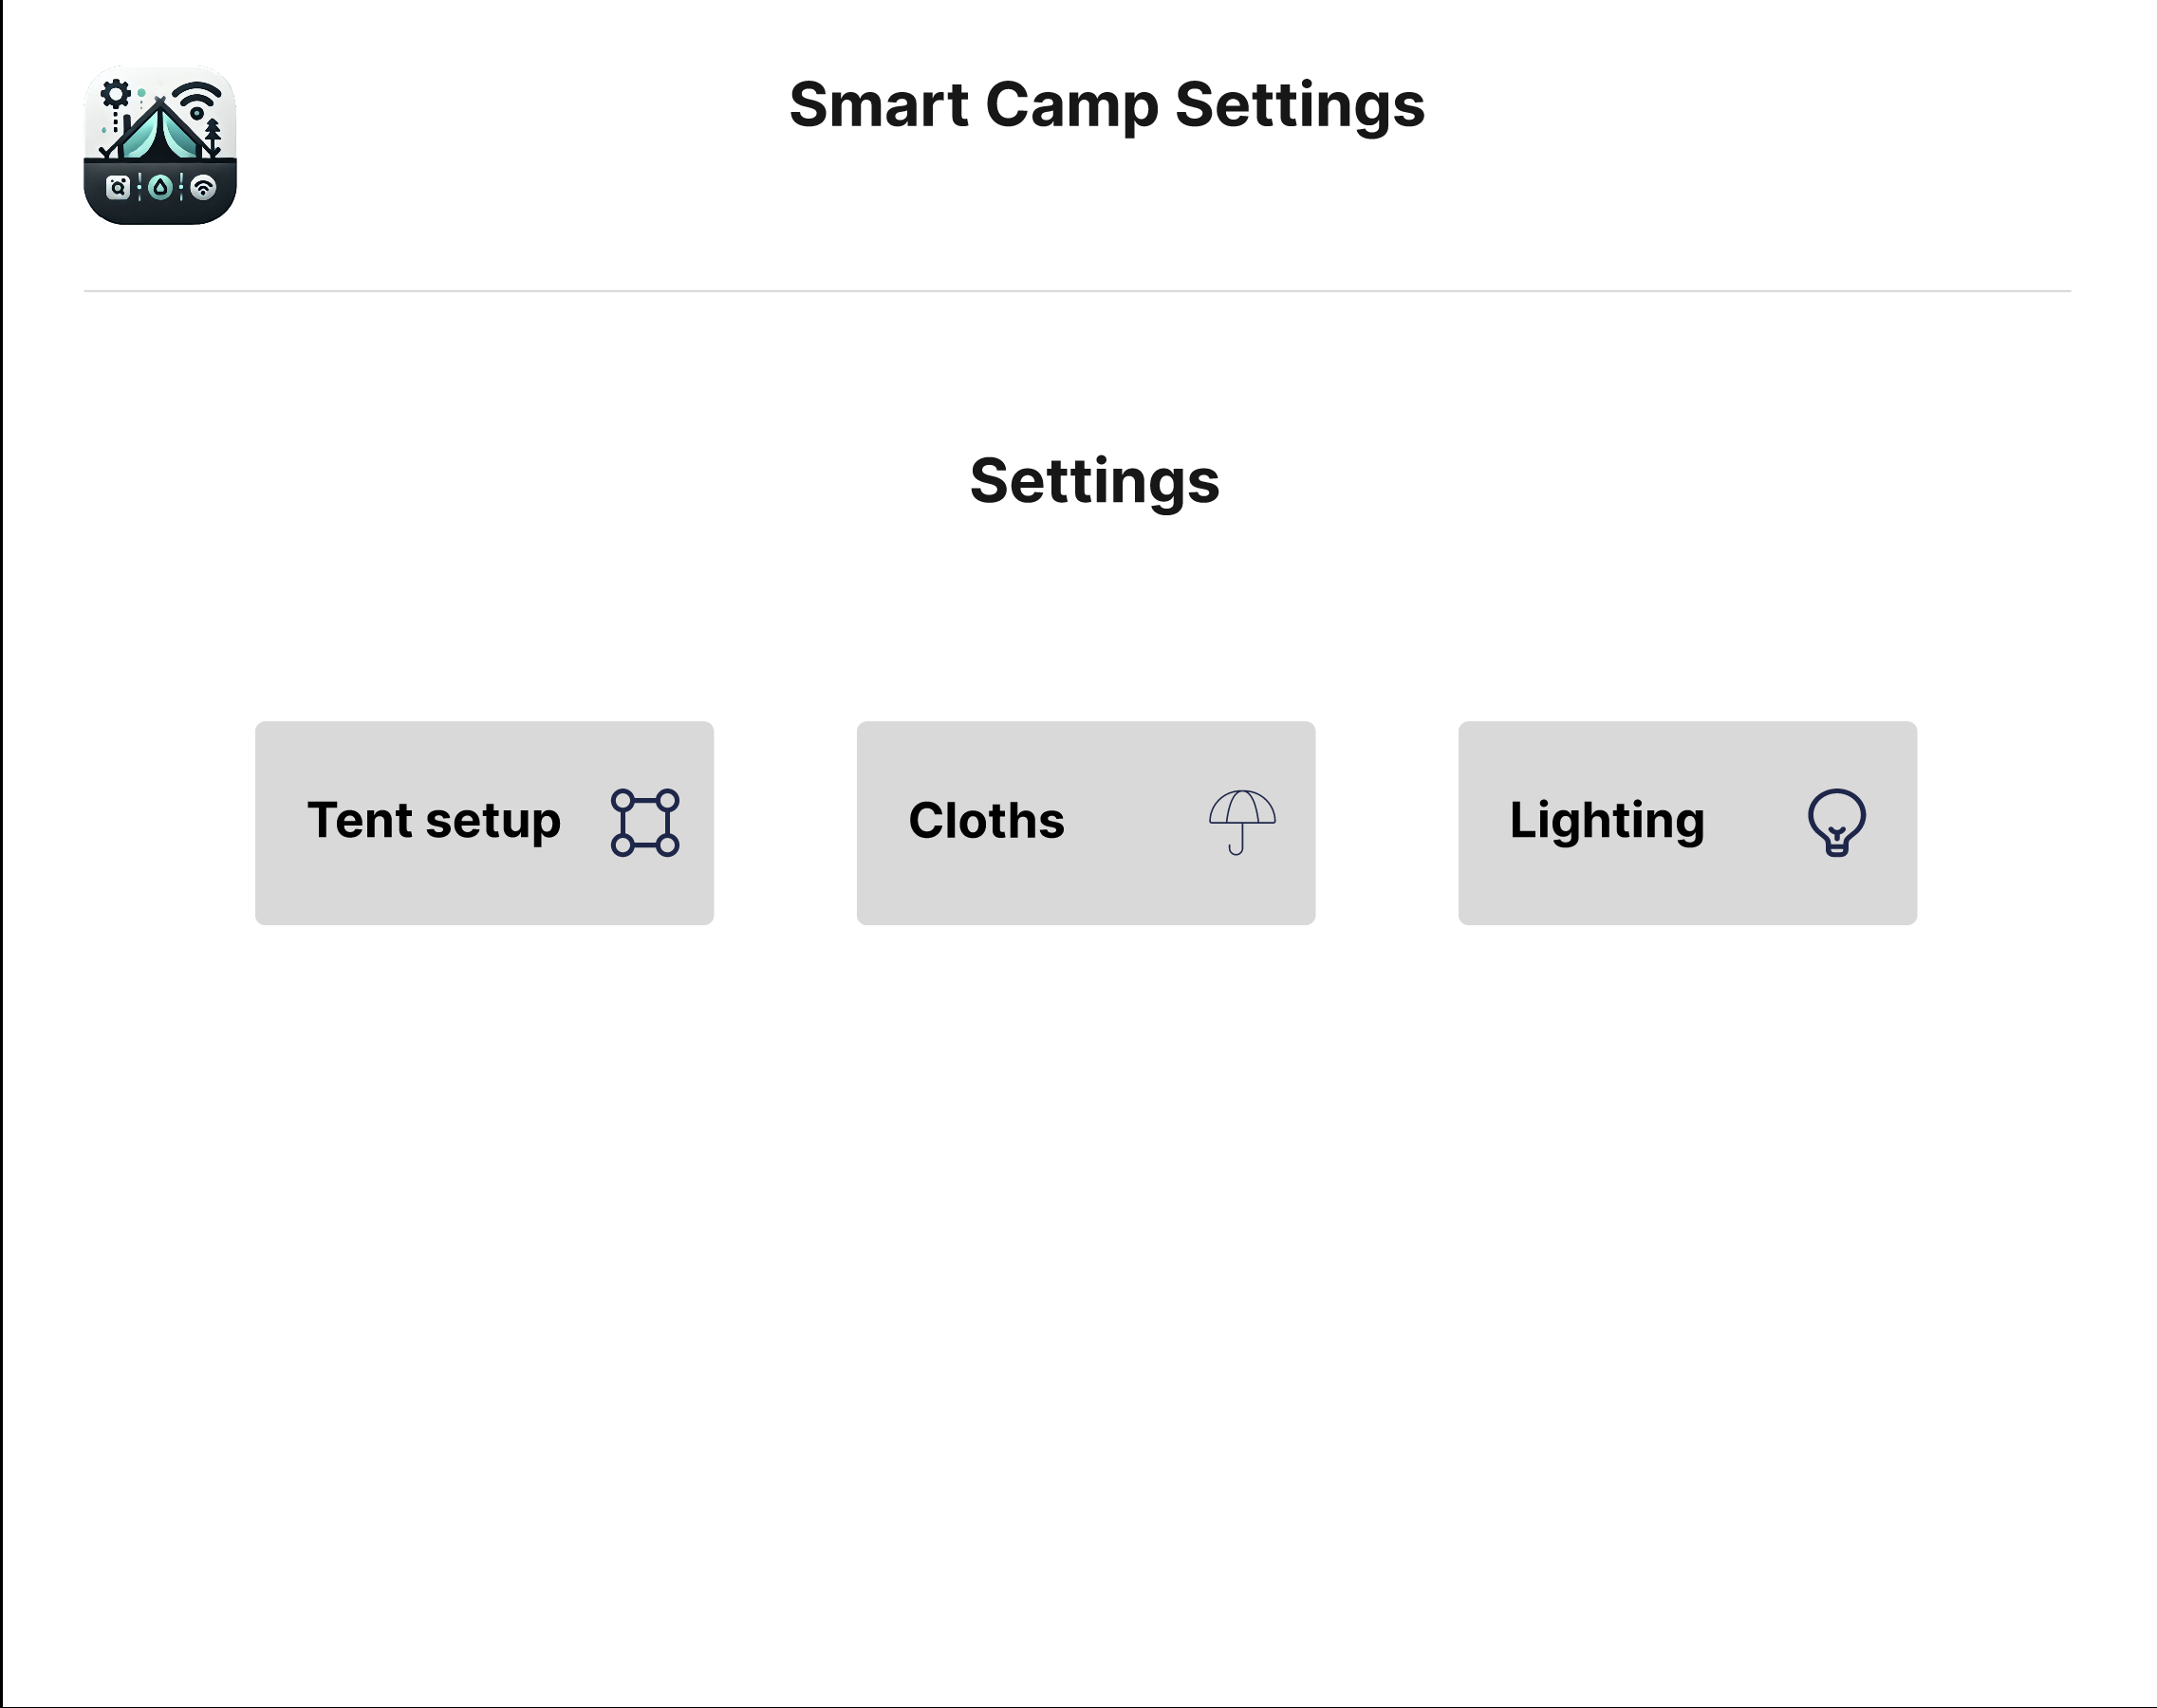
Main Menu
Very simple main screen
Three main options for:
Tent Setup
Cloths
Lighting

Slide 9
Tent Setup
Choosing location
Poles settings

Slide 10
Tent Setup Interface - Position
Allows User to choose location in an intuitive, interactive way
Provides information about point that is being hovered over
Shows suggestions for optimal tent positions

Slide 11
Tent Setup Interface - Setup
Provides tools for accurate setting of each pole
Shows suggestions for optimal settings

Slide 12
Cloths Settings
Precise cloths installation

Slide 13
Cloths Placement
Provides tools for accurate setting of each pole
Shows suggestions for optimal settings
Easy drag and drop interface and real-time preview
Message showing whether or not current setting is optimal

Slide 14
Lighting Settings
Settings for ambient light at nights
Light effects for special occasions (birthday, wedding, funeral)

Slide 15
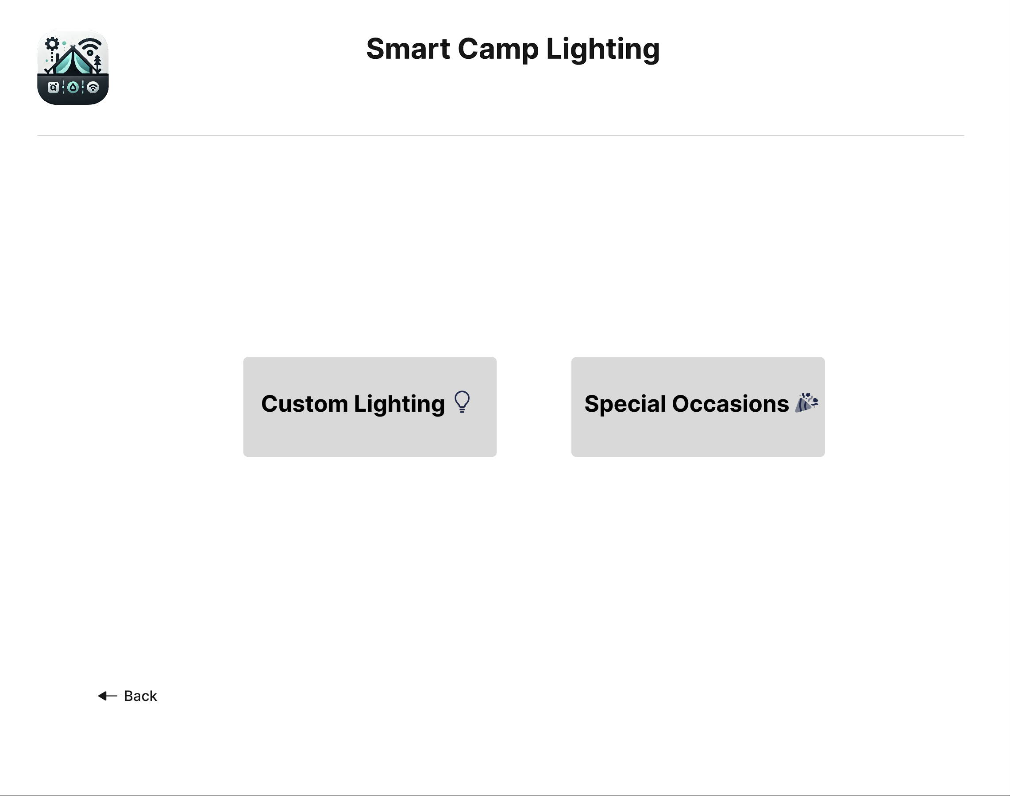
Lighting Settings Menu
Custom Lighting
Special occasions

Slide 16
Lighting Settings – Custom Lighting
AI Powered suggestion of settings based on current weather, time and user’s mood (through NeuraLink’s in-brain chip)
Shows a preview of applied setting via interactive AI – powered animated light bulb

Slide 17
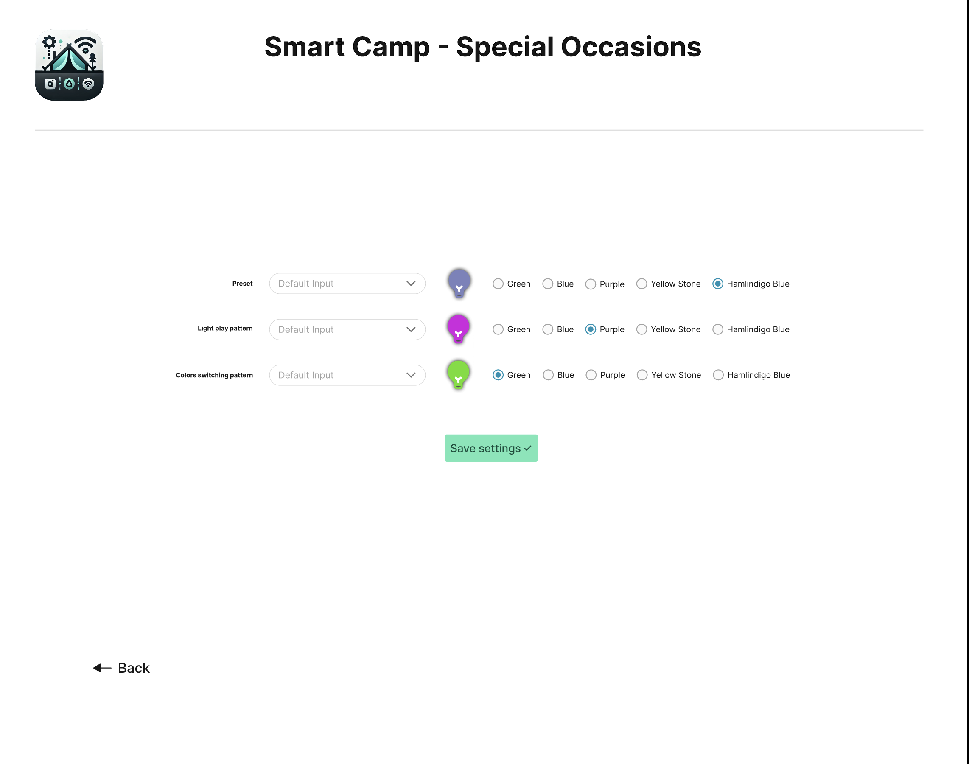
Lighting Settings – Special Occasions
User may choose one of the pre-made lighting settings for predefined types of events (Wedding, Generic Celebration, Funeral)
Settings are shown up on animated lightbulbs
User may choose different colors or same color, such as Green, Purple, Hamlindigo Blue

Slide 18
Documentation
Quick Start Guide
Short Manual (Cheatsheet)
Extended Manual (README.md)

Slide 19
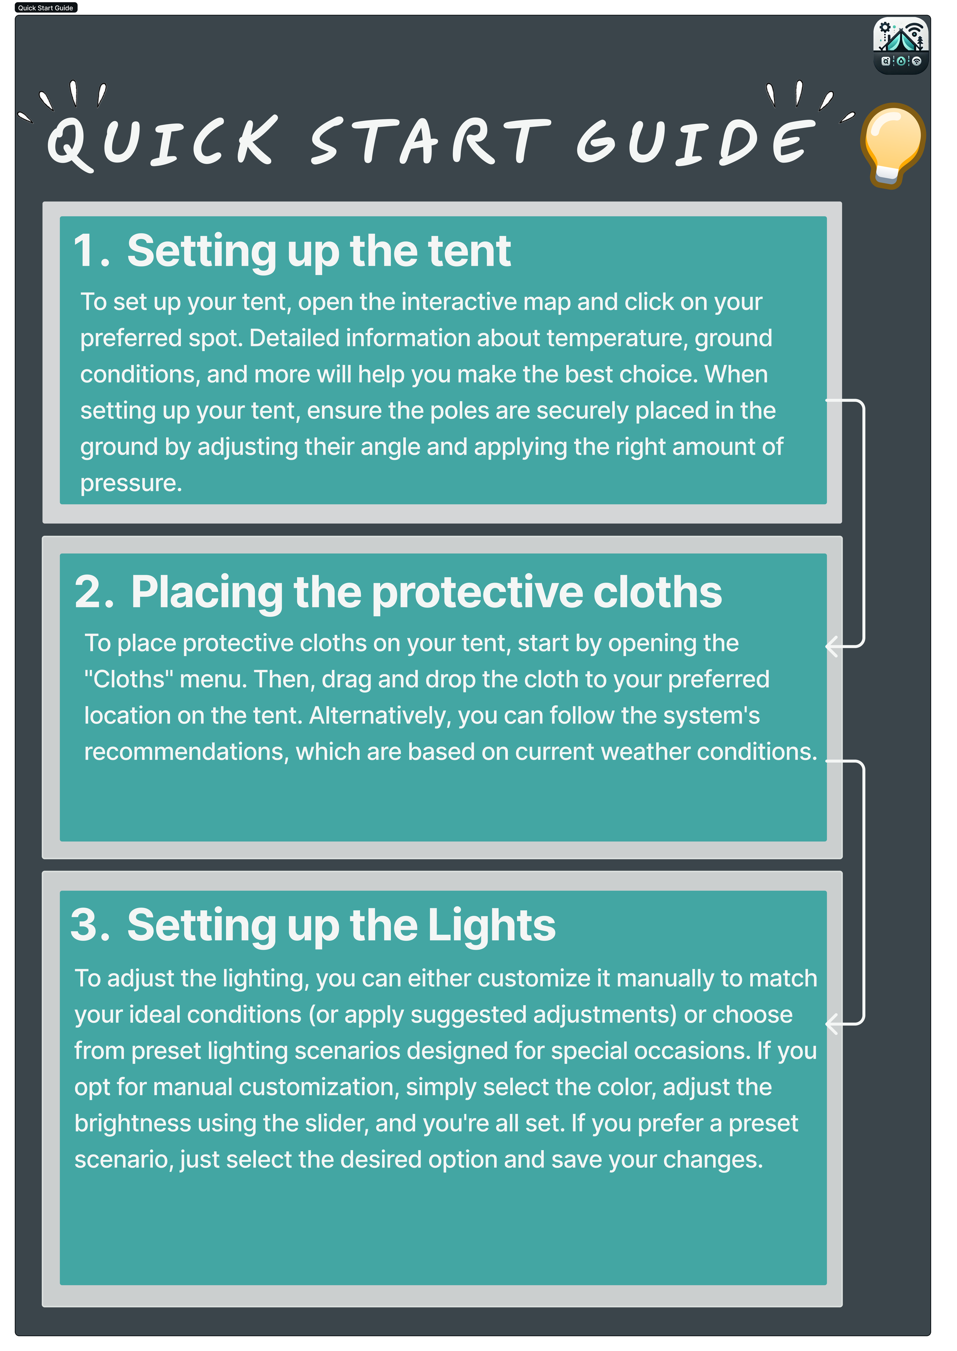
quick start guide
Short manual

Slide 20
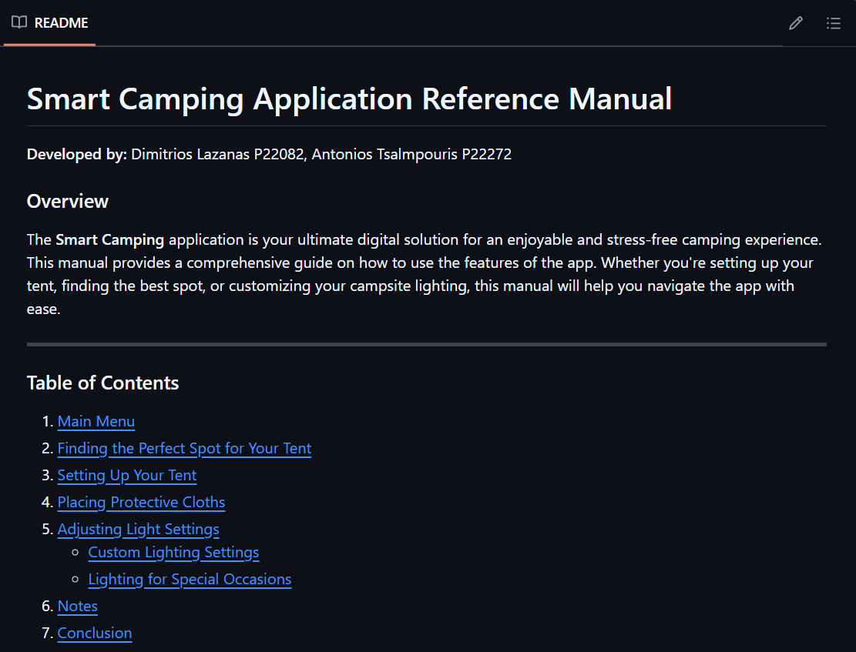
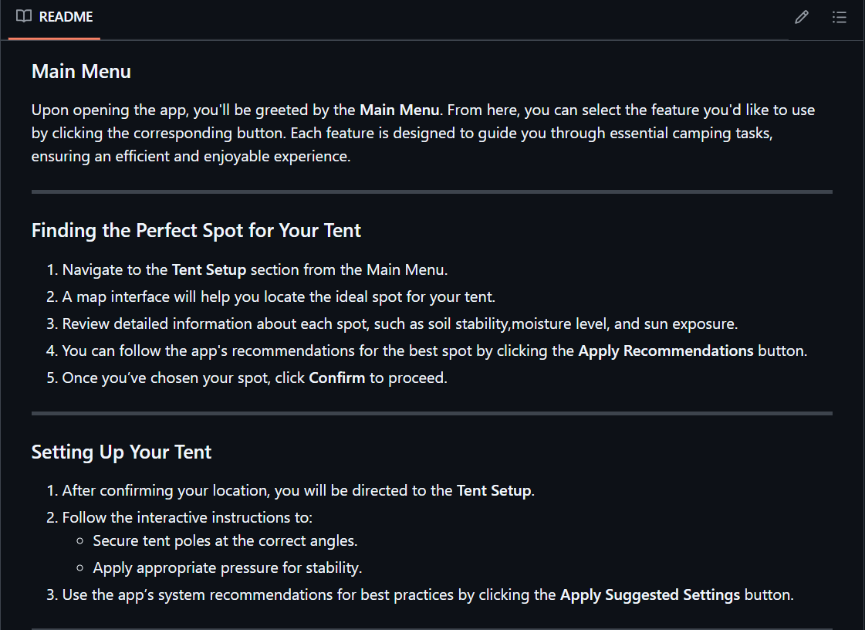
Extended Manual (README.md)

Slide 21

Implementation

Slide 22

Why React Native?
React Native is top – notch technology used by Facebook, Microsoft, Netflix.
Shared codebase among platforms (Windows, macOS), no need to write for each platform.
Good performance, ease of development.
Web developers with little preparation can start writing native applications.

Slide 23
Thank you!
Dimitrios Lazanas P22082
Antonios Tsalmpouris P22272
Find our repository on Github!

